Slide 1

AMAZON SALES
A wide range of tasks are included in sales management, such as arranging and planning sales
campaigns as well as leading and inspiring sales personnel. It acts as the pivot that joins the
production of goods and services to the final customer, guaranteeing the successful and
efficient delivery of items to the market.
The purpose of sales management in a commercial and corporate entity is not limited to
transactional tasks; rather, it plays a crucial role in the strategic alignment of organizational
objectives with market prospects.

Slide 2
AMAZON SALES
Details of Data:
Timely Data:
Order Date and Ship Date are the date data type and it is updated to check the most current sales performance.
2. Regional Data:
Contains information on regions and countries where are orders are taken.
Provides the Amazon’s market insights and sales performance.
3. Granular Details:
Item type contains the information of each product which is being ordered.
Provides the in-depth information and most selling product.

Slide 3
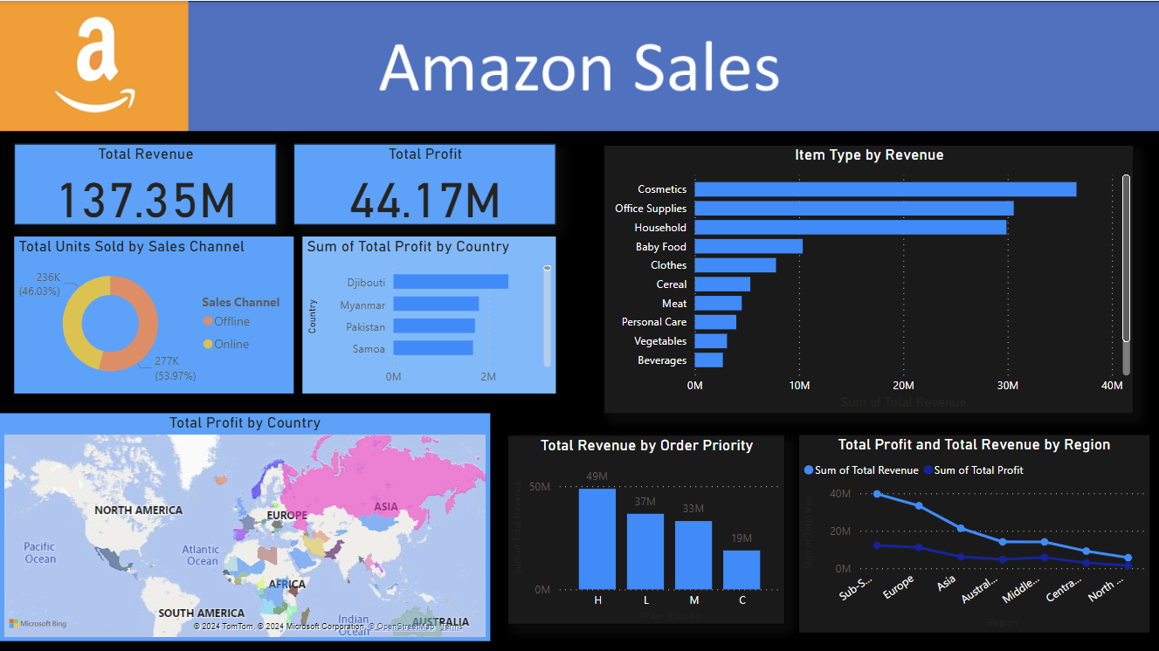
AMAZON SALES

Slide 4

AMAZON SALES
Key Performance Indicators:
Total Revenue: The total revenue generated from sale by Amazon, providing the information to understand the sales performance.
Units Sold: Providing information about products to give insights into demands and trends.
Total Profit: Net profit generated from different regions and countries.

Slide 5

AMAZON SALES
The most units sold is by Sub- Saharan Africa.
Maximum Revenue generated from Cosmetics, minimum from Fruits.
Maximum Profit is generated from offline ordering.
The maximum units sold in the 2014 year.
Significant difference in revenue and profit for Office Supplies and Household items.
Lowest profit in countries: Kuwait, New Zealand , Syria, United Kingdom.

Slide 6
AMAZON SALES
Thank You!

